Slide 1
ONLINE LEARNING PLATFORM USING MERN
TEAM NUMBER:ADSG04
TEAM MEMBERS:
ALIN HIMA S (211521243008)
JHANSI V K (211521243078)
KOTAPATI VENKATA SESHA SAI HIMAJA(211521243092)
LATHIKA R(211521243096)

Slide 2
TABLE OF CONTENTS
ABSTRACT
INTRODUCTION
PROPOSED SYSTEM
IMPLEMENTATION: MERN STACK
FRONTED
BACKEND
INTERGRATION
BLOCK DIAGRAM
MODEL SCREENSHOT
CONCLUSION

Slide 3
ABSTRACT
This project presents the development of an online learning platform using the MERN stack (MongoDB, Express, React, and Node.js). The platform aims to provide a seamless, user-friendly experience for students and educators by offering courses, assessments, and real-time interaction. MongoDB serves as the database to store user information, course content, and progress tracking, ensuring efficient data handling. Express and Node.js power the backend, facilitating secure and scalable communication between the database and the frontend. React is employed for the user interface, ensuring a dynamic and responsive environment for users. Key features include user authentication, a variety of multimedia learning modules, progress tracking, and discussion forums. This platform is designed to enhance remote education by offering flexibility, accessibility, and engaging learning experiences.

Slide 4
INTRODUCTION
In recent years, the demand for online learning platforms has surged due to the increasing need for flexible, accessible, and interactive education. Traditional classroom settings are no longer the sole means of acquiring knowledge, as learners worldwide seek alternatives that fit their schedules and learning styles. The MERN (MongoDB, Express, React, Node.js) stack has emerged as a powerful technology suite for building scalable, high-performance web applications. This project focuses on developing an online learning platform using the MERN stack, which offers a robust solution for managing user data, delivering dynamic content, and providing real-time interactions between educators and learners. The platform aims to create a cohesive ecosystem where students can access a variety of courses, track their progress, participate in discussions, and engage in assessments. By leveraging the strengths of each technology in the MERN stack, the platform provides a responsive and user-friendly experience, ensuring effective delivery of educational content in a modern, digital-first environment.

Slide 5
PROPOSED SYSTEM
The proposed system is a web-based platform that provides users with the ability to:- Register and log in to their accounts.- Submit detailed complaints by filling in necessary information, including description, contact details, and attaching relevant documents.- Track the status of their complaints in real-time and receive notifications about updates via email or SMS.- Communicate directly with assigned agents to provide additional information or feedback.- Benefit from enhanced security features such as data encryption, user authentication, and compliance with data protection regulations.Additionally, the platform equips administrators with the tools to manage the allocation and resolution of complaints, ensuring efficient handling and resource management. Intelligent routing algorithms direct complaints to the appropriate department, while administrators can oversee agent performance and maintain overall system integrity.

Slide 6
IMPLEMENTATION:MERN STACK
FRONTEND
Material UI/Bootstrap: These libraries are used to ensure a visually appealing and responsive user interface, providing a seamless and intuitive experience across devices for students and educators alike.
Axios: This tool facilitates smooth communication between the frontend and backend, efficiently handling HTTP requests to ensure that data is fetched and displayed in real time, enhancing the overall learning experience.
Real-Time Updates: By integrating Socket.io, the platform supports real-time communication, allowing for features such as live class notifications, instant feedback, and real-time progress tracking. This ensures a dynamic and interactive learning environment, keeping users engaged and informed at all times.

Slide 7
BACKEND
Server-Side Logic: Managed by Express.js, the platform efficiently handles routes and APIs for course enrollment, user authentication, lesson management, and progress tracking.
MongoDB: A NoSQL database used to store user profiles, course materials, assessments, and completion records. By utilizing MongoDB Atlas, the platform benefits from cloud storage, enabling scalability and secure data management.
APIs: RESTful APIs facilitate the flow of data between the frontend and backend, supporting CRUD operations (Create, Read, Update, Delete) for courses, user progress, assignments, and real-time interactions with educators.

Slide 8
INTEGRATION
Frontend-Backend Communication: Axios is used on the frontend to send API requests to the backend, which is handled by Express.js. This allows for seamless data exchange for functionalities like course enrollment, fetching lesson content, and student-instructor communication.
Database Integration (MongoDB): The backend interacts with MongoDB to store and retrieve data related to users, courses, and progress tracking. Express.js communicates with the database via Mongoose, a Node.js library that efficiently handles MongoDB queries.
Real-Time Features: Socket.io enables real-time interaction between students and instructors, allowing for live Q&A, chat during lessons, and instant progress updates. Additionally, WebRTC could be integrated for voice/video tutoring sessions to provide a more immersive learning experience.

Slide 9
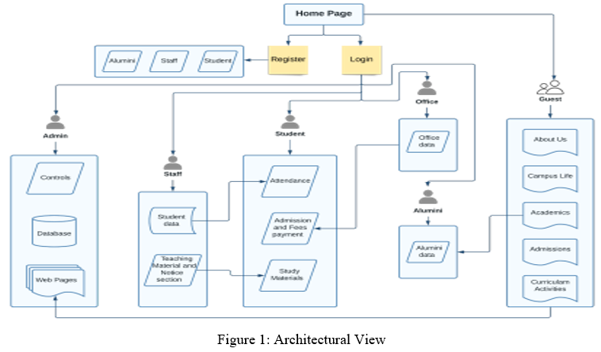
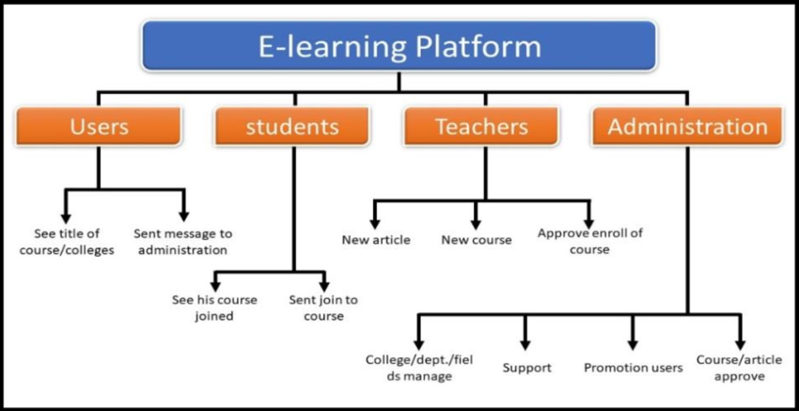
BLOCK DIAGRAM

Slide 10
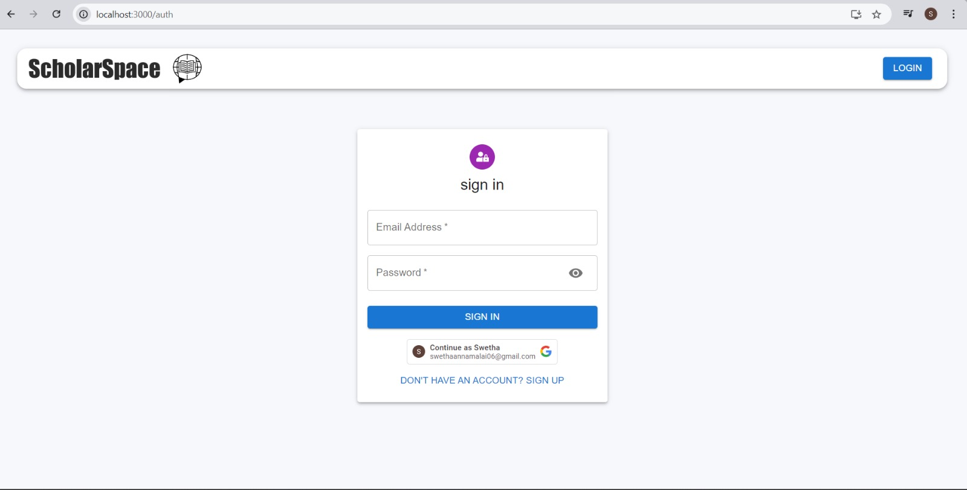

MODEL SCREENSHOT

Slide 11
CONCLUSION
The Online Learning Platform built on the MERN stack provides a robust, scalable, and user-friendly solution for delivering educational content. By utilizing the latest web technologies, the platform ensures an engaging learning experience with real-time updates, secure data management, and a responsive design. The flexibility of the system allows for seamless integration of multimedia resources, personalized learning paths, and interactive features. Its scalability makes it suitable for institutions of various sizes, enabling efficient management of student progress and fostering a more immersive and dynamic learning environment.

Slide 12
THANK YOU

